Slide 1

Financial Plan Review
Karen Graham & Albie O'Hanian
October 20, 2023
Notes:
Jerome to populate Client name; date

Slide 2
Our Meeting Agenda
I. Goals Review
II. Financial Plan Outlook Review
Net worth
Income sources
Retirement cash flow summary
III. Financial Planning Considerations
Tax optimization
Insurance policies
Mortgage
IV. Estate Planning
V. Investment Portfolio Overview
Asset allocation
Performance
Annual portfolio cash flows
VI. Account Management

Slide 3
I. Goals Review
Retirement Savings & Retirement Income
Tax Reduction & Deferral
50% of Children’s Education
Florida Retirement Home
Sample goals
Notes:
Deck prep commentary:
Manual input
After ratifying Financial Goals, team may move to leverage the Conquest tool to review plan details in more depth, make real-time changes, and/or scenario plan.
Client facing Questions/Commentary – Retirement Goals:
Is the client happy to be on track against their goals or do they want to exceed them?
What happens with the RESP if their child doesn’t go to school?
Will they be on track if the market crashes or inflation increases?
What if the client needs to increase health care costs?
Will their spouse be ok if one person passes away before the other?
Client may ask if they could run out of money?

Slide 4
II. Financial Plan Review
Net worth and Investment Accounts
Income sources
Retirement cash flow summary
Account cash movement
RRSP / TFSA Contribution Room

Slide 5
Net Worth
Consider consolidating Net Worth and following Income Sources on one slide
Assets | Asset Value
Notes:
Manual inputs

Slide 6
Incomes Sources
Income Sources | Source Amount
Notes:
Deck prep:
Formerly ‘Cash Flow’ slide
Manual inputs
Client-facing questions:
Is the client fully using any employer-matching in their pension?
How will inflation impact their pension?
What survivor benefits are built into their pension?
When is the best time to start CPP and OAS?
What is the maximum amount they can spend?

Slide 7
Investment Accounts Overview
Account Owner | Account Type | Market Value
{#Accounts}{ClientName} | {AccountType} | {MarketValue}{/Accounts}
Accounts Total
$1,239,253.62
Notes:
Jerome to populate Veritable Account holdings

Slide 8
Account Contributions / Withdrawals
 | {ContAndWithTitle3} | {ContAndWithTitle2} | {ContAndWithTitle1}
{#ContAndWith}{Title} | {Value3} | {Value2} | {Value1}{/ContAndWith}
Notes:
Jerome to populate flows of contributions into accounts (RRSP: purchases etc) or withdrawals from accounts (RRIF)

Slide 9
RRSP / TFSA Contribution Room
Karen
TFSA Contribution Room = $6,500
2022 RRSP Contribution Limit = $97,809
Albie
TFSA Contribution Room = $6,500
2022 RRSP Contribution Limit = $103,647
Notes:
Jerome to populate Client names
Jerome to link to CRA with new API to populate

Slide 10
III. Financial Planning Considerations
Tax optimization
Insurance policies
Mortgages held

Slide 11
Tax Optimization
Considerations:
RRSP Contribution
Spousal RRSP Contribution
Tax Credit Optimization
Basic Personal Exemption
Age Amount
Pension Credit
Disability Tax Credit
Charitable Giving
Canada Child Benefit
GST Credit
Tuition Tax Credit
Alternative Minimum Tax
Realized Capital Gains/Losses
Carry forward
Carry back
Tax Loss Selling
Home Buyer Plan Repayment
Lifelong Learning Repayment
Pension & Income Splitting
For discussion:
1. RRSP Contributions
2. Medical Expenses & Charitable Donation tax credits
3. Disability Tax Credit
4. Income classification – Salary vs. Dividend
Income Optimization
Salary vs. Dividends
Additional Taxable Income
Tax Deduction Optimization
Interest Expense & Carrying Charges
RRSP Deductions
CPP Self-Employment Deduction
Union & Professional Dues
Self Employment Expenses
Work From Home Expenses
Moving Expenses
Medical Expenses
Childcare Expenses
TFSA Maximization
Taxes filed & up to Date
Investment Location Planning
Estate/Trust Considerations
GRE
Rights or Things Return
Notes:
Deck Prep: Team to manually populate left side content based on Client
Client-facing questions:
Ensure the client is managing their taxable income by strategically using RRSP contributions/withdrawals?
Does the client hold non-reg holdings to donate to avoid capital gains?
Should the client contribute to their RRSP just prior to converting to a RRIF?
Is the client eligible for GIS in retirement?
Is the client taking advantage of all available credits and benefits?

Slide 12
Insurance review
Insurance Policy | Policy Amount
Notes:
Deck prep note:
** Team may leverage the Conquest tool to review this information and implications of changes
Manual inputs
Client-facing questions:
Are there potential catastrophic risks the client might be vulnerable to?
What are suitable amounts of insurance protection?
How long will the client need insurance coverage for?

Slide 13
Mortgage review
Mortgage | Mortgage Amount
Notes:
Deck prep notes:
** Team may leverage the Conquest tool for this information review
Manual inputs
Client-facing questions:
Could the client get a better rate for any outstanding liabilities?
Would borrowing money be beneficial to achieve the client’s goals?

Slide 14
IV. Estate Overview
Beneficiaries
Will
Power of Attorney

Slide 15
Estate Overview
Will:
Executor:
Last updated:
Account Beneficiaries:
Karen’s Accounts: (SUCRS for TFSA)
Albie’s Accounts: (SUCRS for TFSA)
Power of Attorney:
Property:
Personal care:
Notes:
Deck prep: Manually input if known
Client-facing questions:
Are your wills up to date and do they clearly state your wishes?
Have you discussed your estate with your trustees?
Do you have powers of attorney in place?
Are your documents and important information organized and accessible for your trustees?
Is the retirement plan mindful of the estate planning goals?
Is insurance suitable for enhancing the clients’s estate value?

Slide 16

V. Investment Portfolio Overview
White Veritable Investment Management logo
Your Portfolio Management team
Matt Galbraith Portfolio Manager
Douglas Schein Chief Investment Officer

Slide 17
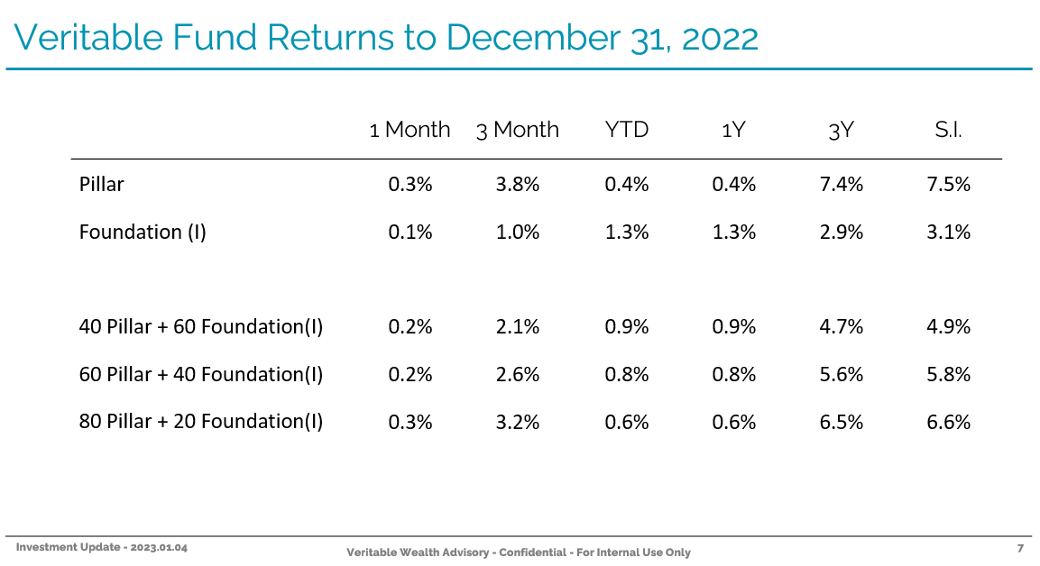
{Client name } Investment Portfolios Performance
To be updated
Customize which client portfolio mix
Notes:
Deck prep:
Jerome to populate with Douglas’s monthly performance updates
Jerome to present only the portfolio mix the Client holds
Client-facing questions:
What rate of return is needed to meet Client goals?
Is the asset allocation suitable to the client’s goals?
Is the asset location tax-optimal?

Slide 18
{Client name} Asset Allocation
Customize client portfolio mix
Update to remove percentages and leave legend / new font
Header and legend
Notes:
Jerome to personalize header with Client name
Jerome to update pie chart based on Client portfolio mix

Slide 19
Veritable Investment Portfolios
Protected against downside risk
Steady, smooth performance trend
To be updated
Notes:
Douglas to update
Manually update quarterly

Slide 20
VI. Account Management
A few topics to review :
Know-Your-Client (KYC) Update and Signature
Privacy Statement Acknowledgment
Confirm Letter of Engagement on file

Slide 21
Thank you.

